Slide 1
How to use my website.

Slide 2

Part 1: Navigation
Takes you to the different sections of my website
Takes you to this PowerPoint
Takes you to the about me section

Slide 3
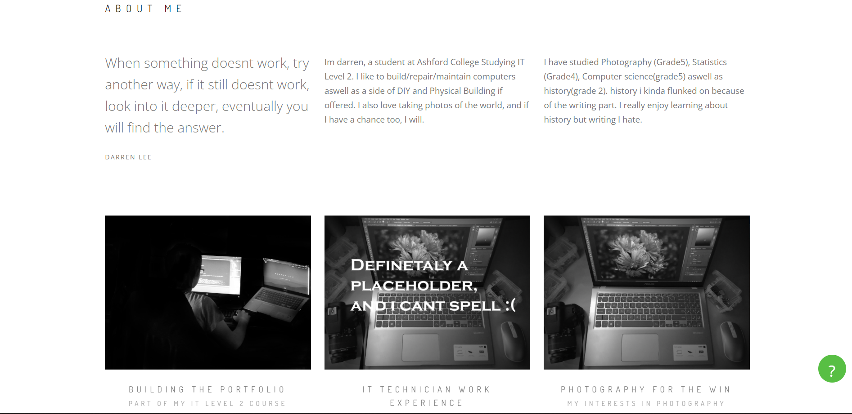
Part 2: About me
Click these to take you to my work

Slide 4
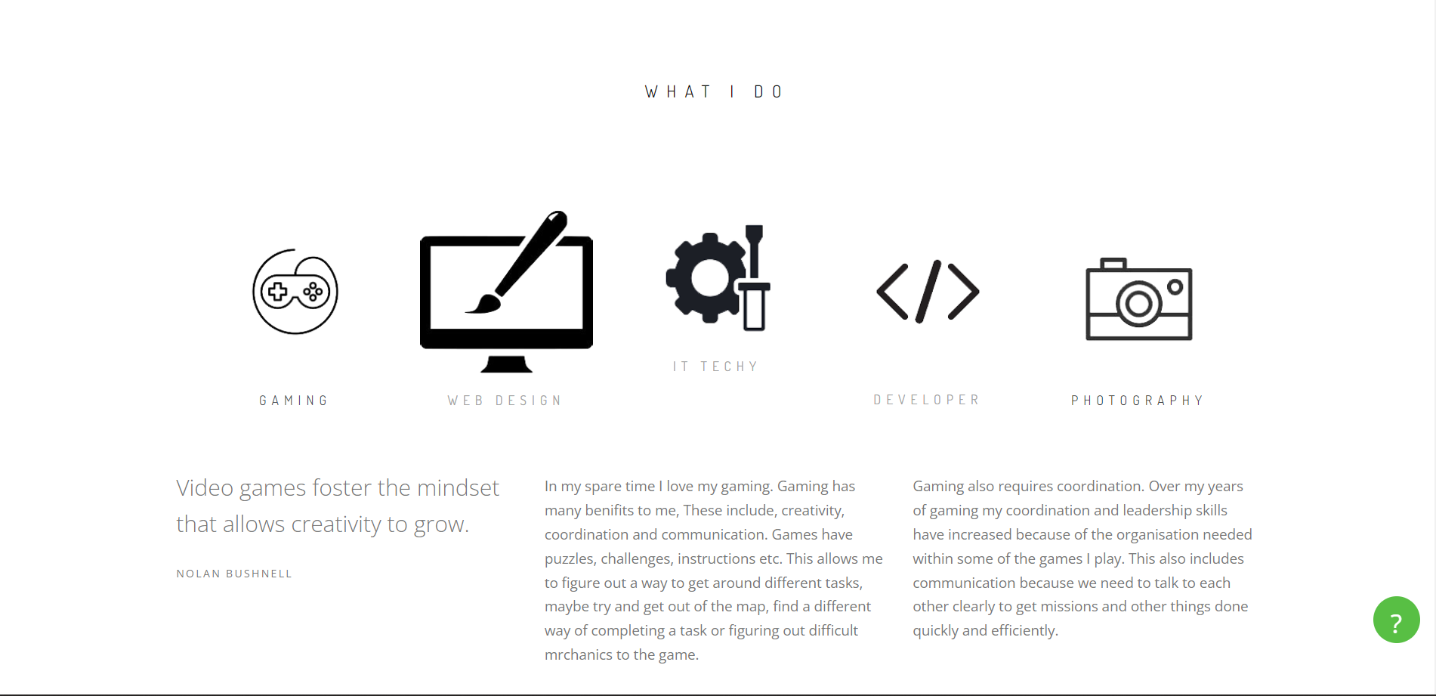
Part 3: What I do
Click these to change this text

Slide 5
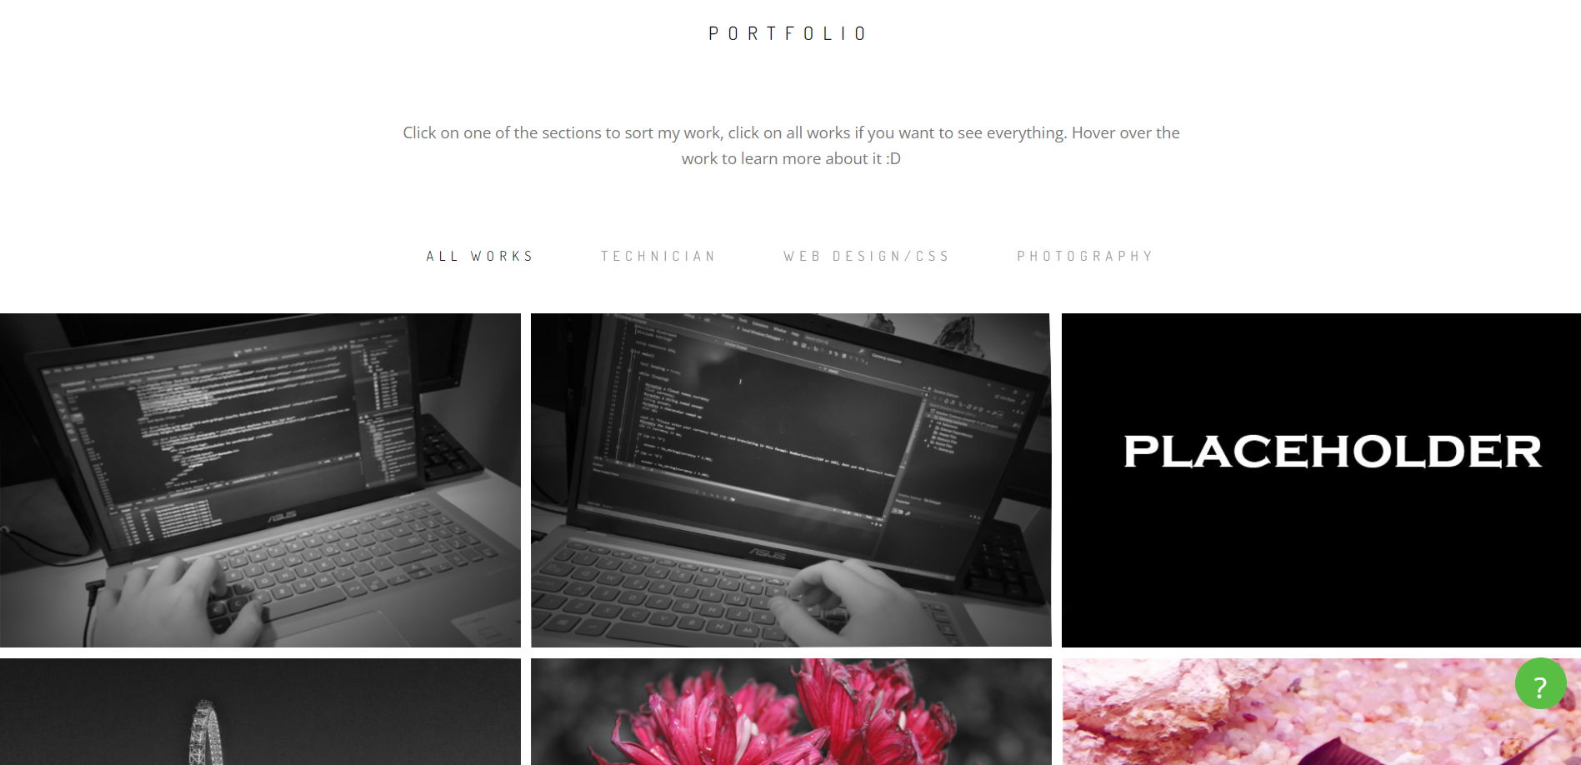
Part 4: The portfolio
Click these to sort the images

Slide 6
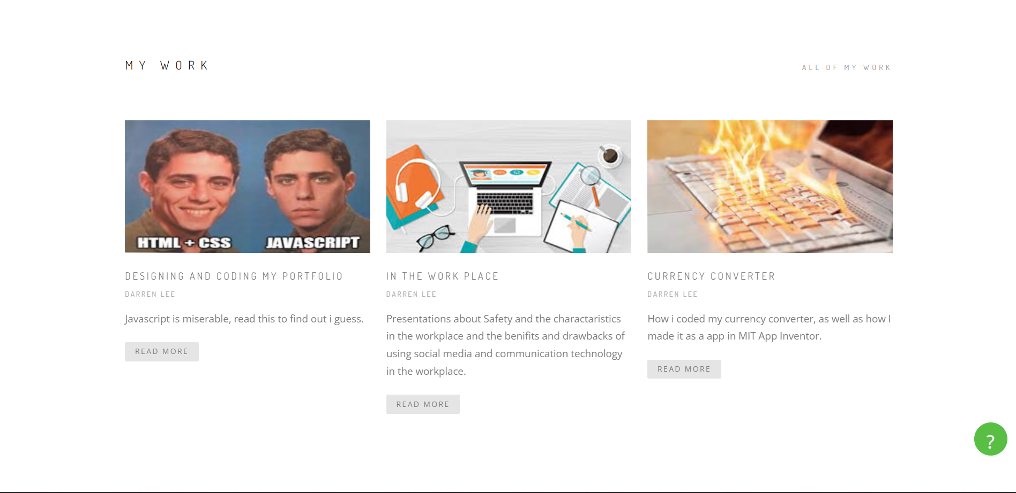
Click here to learn more about my work

Slide 7
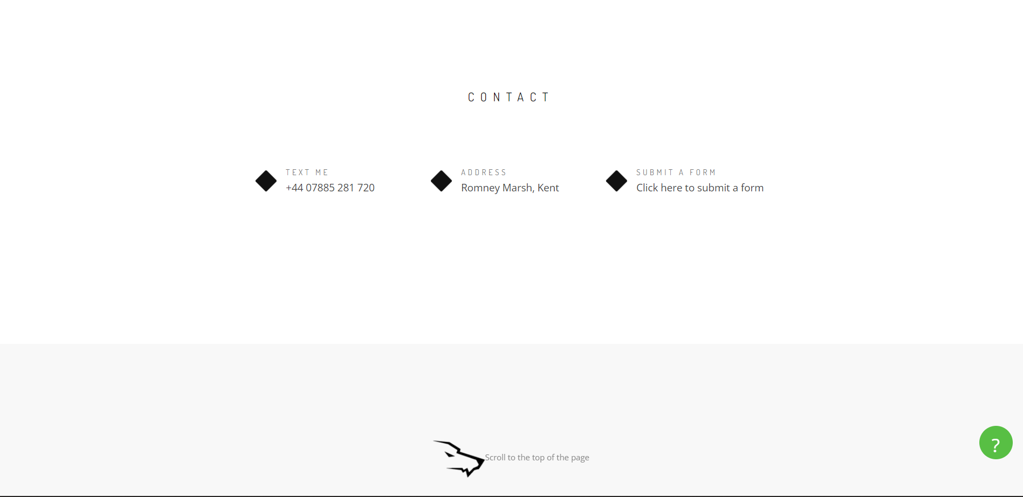
Part 6: Contact
Click here to submit a form to get in touch with me
Click here to scroll to the top of the page

